Slide 1

INTEGRATED CAPSTONE PROJECT CHECKPOINT - 3
Sri Praveena Geddam(DELBC8001)
Hebbar Sumukh(DELBC8002)
Niyatee Nibedita Panda(DELBC8003)
Yogam Rakshana R(DELBC8004)
Ukash Bhat(DELBC8005)
Batch – H
Group - H1

Slide 2
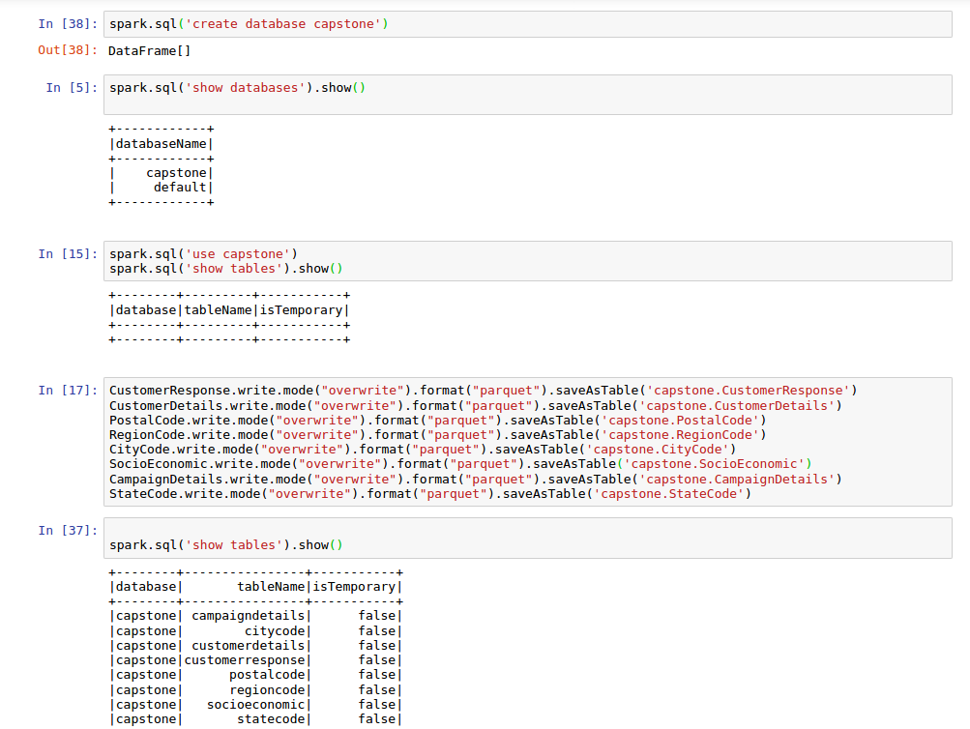
Task 3.1 – Data Analysis using Big Data Tools

Slide 3
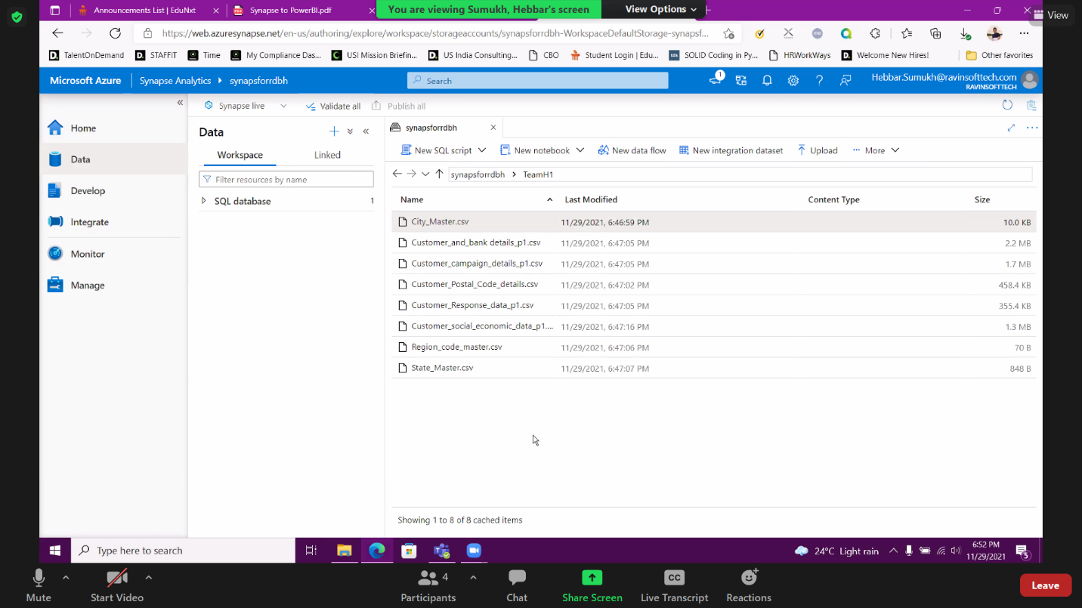
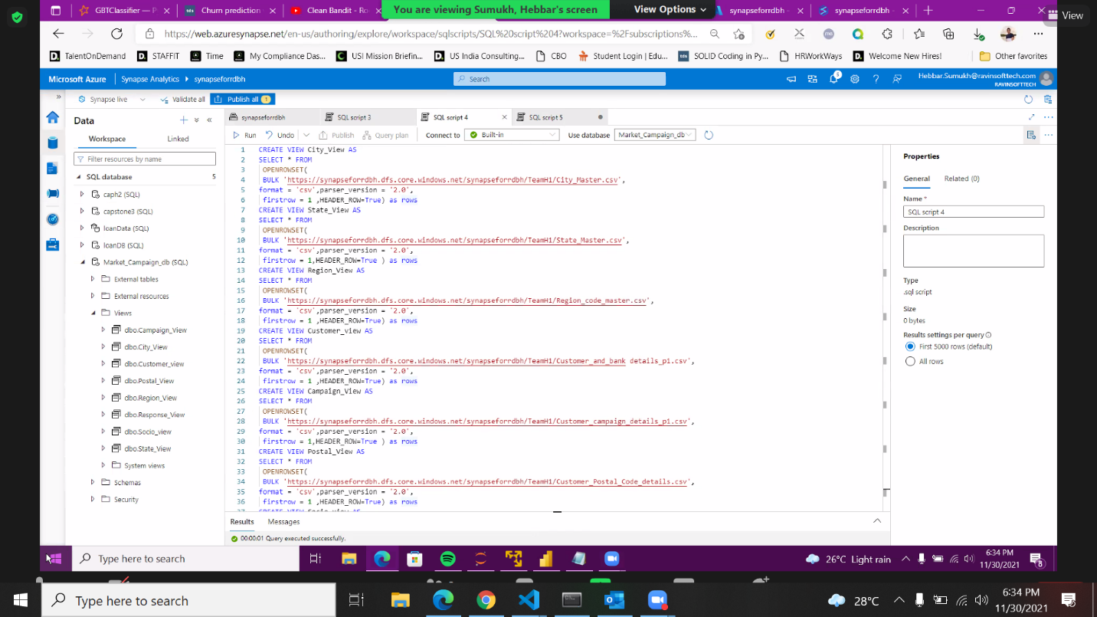
Task 3.2 – Data Analysis on Cloud
Created a folder with some valid name to upload your datasets to azure synapse storage Gen1
Created a srverless SQL pool to query the data from storage gen1 and create view tables

Slide 4
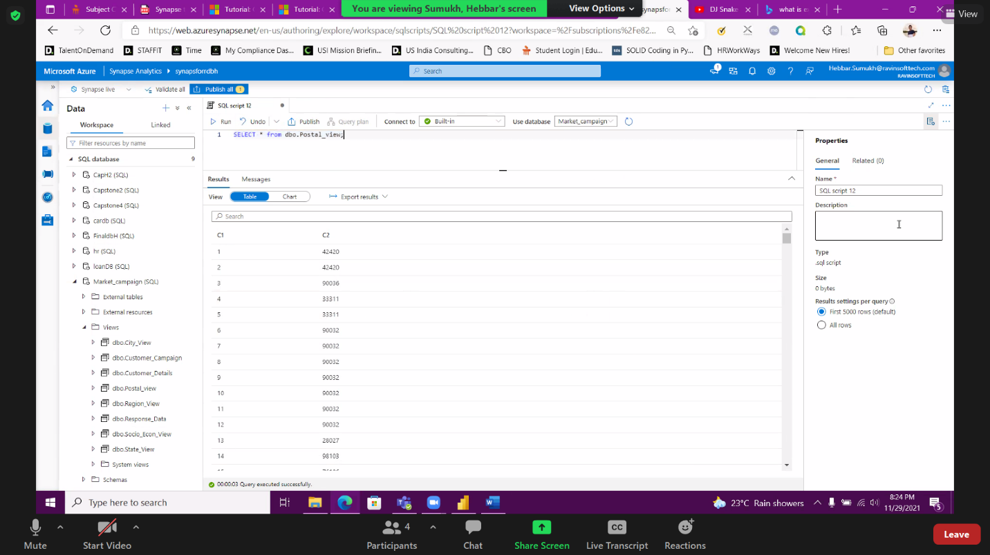
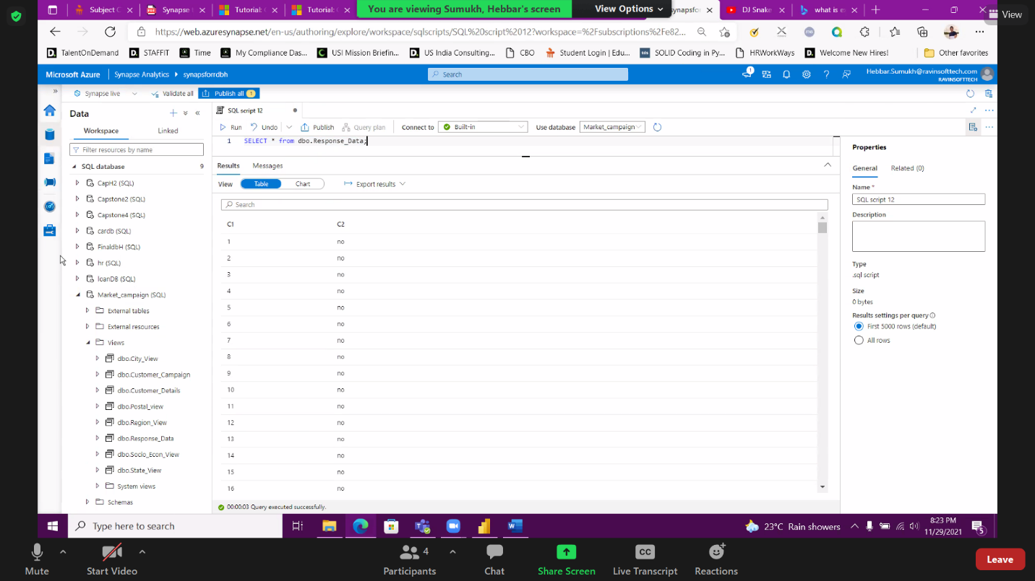
Checked the view created by writing select queries and saved all the tables

Slide 5
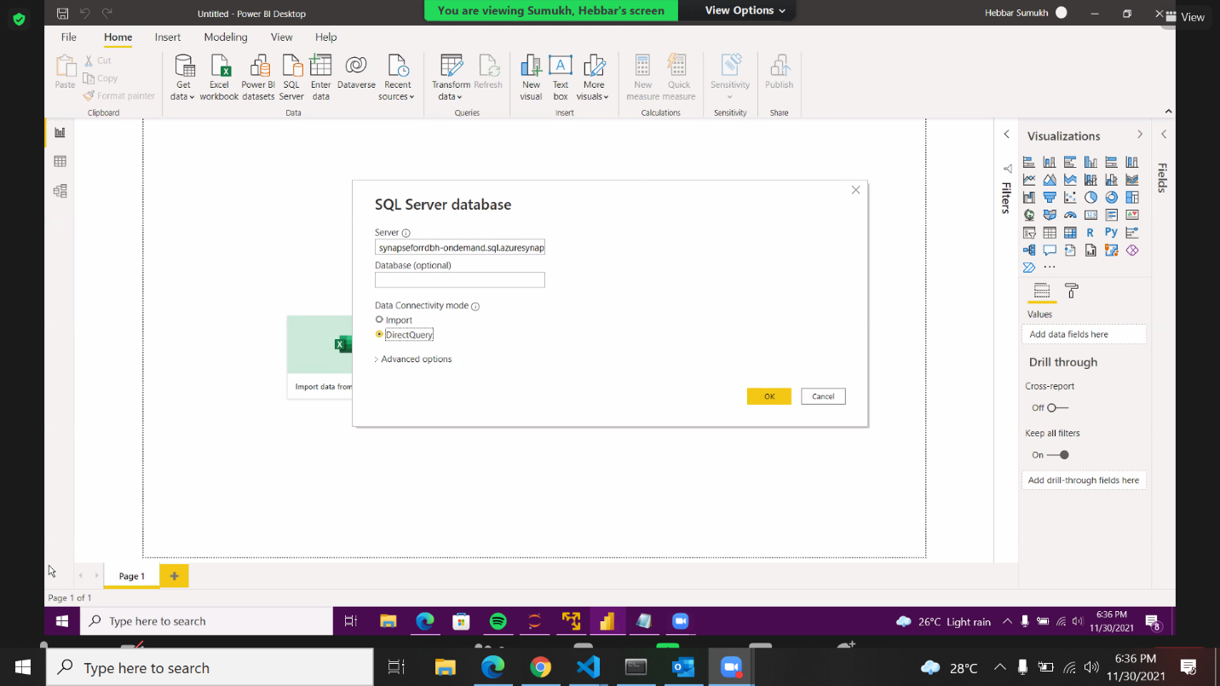
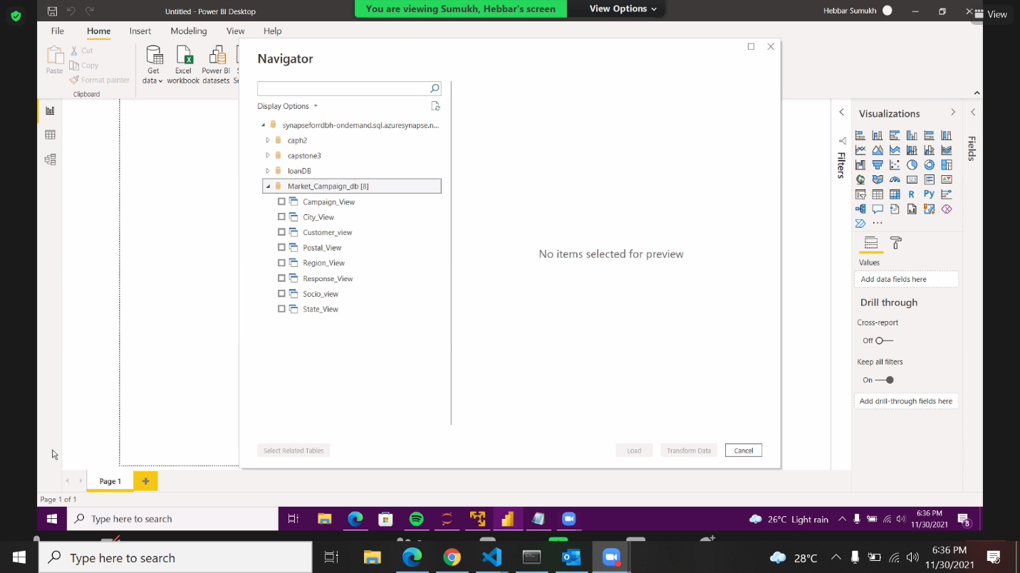
Linking the PowerBi to SQL Serverless database and viewing the list of view tables in PoweBi
Provide Synapse- Serverless SQL endpoint and selected “Direct Query”
List of view tables in PowerBi

Slide 6
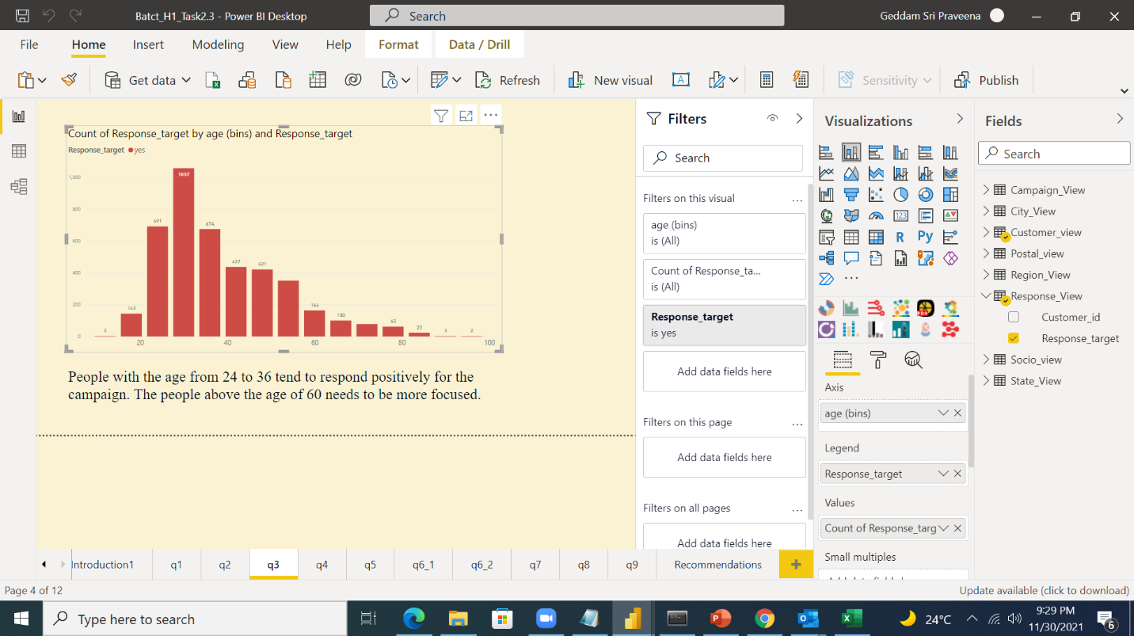
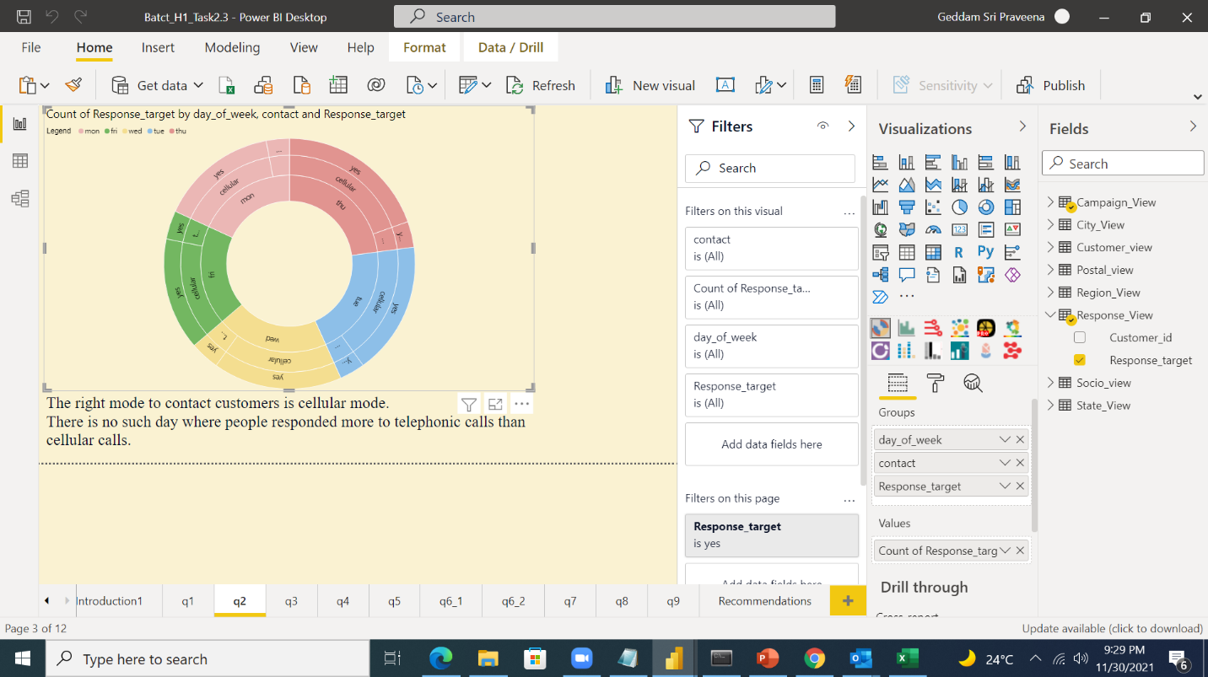
Various Analytics on PowerBI
People with age group 24 to 36 tend to respond more
The right mode to contact the customers is the cellular mode

Slide 7
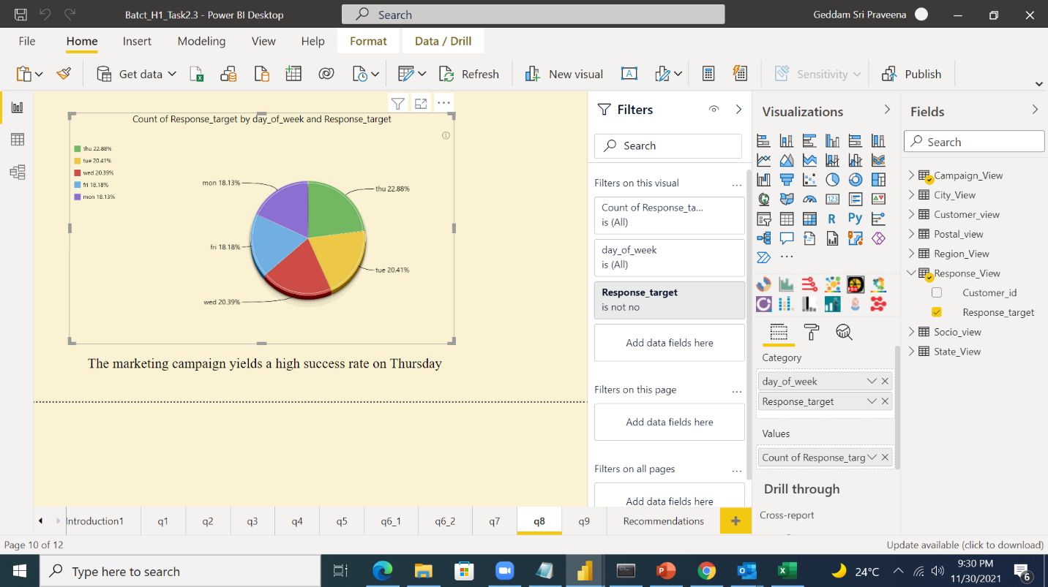
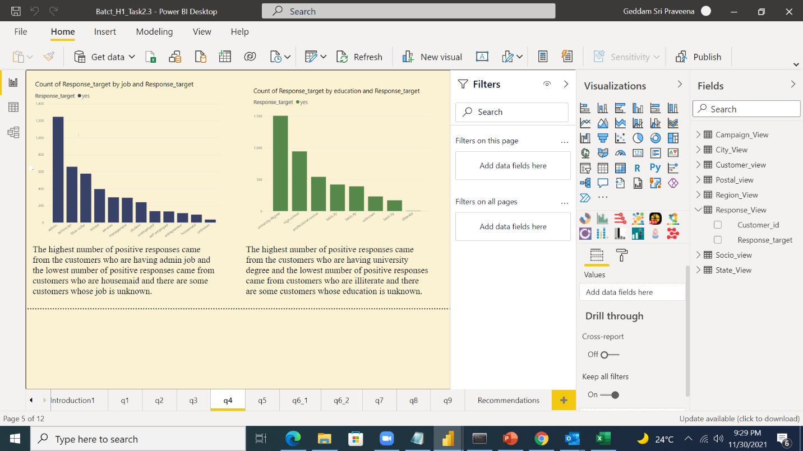
Thursday yields a high success rate
The highest number of response came from the customers who are having job and who are aving university degree

Slide 8
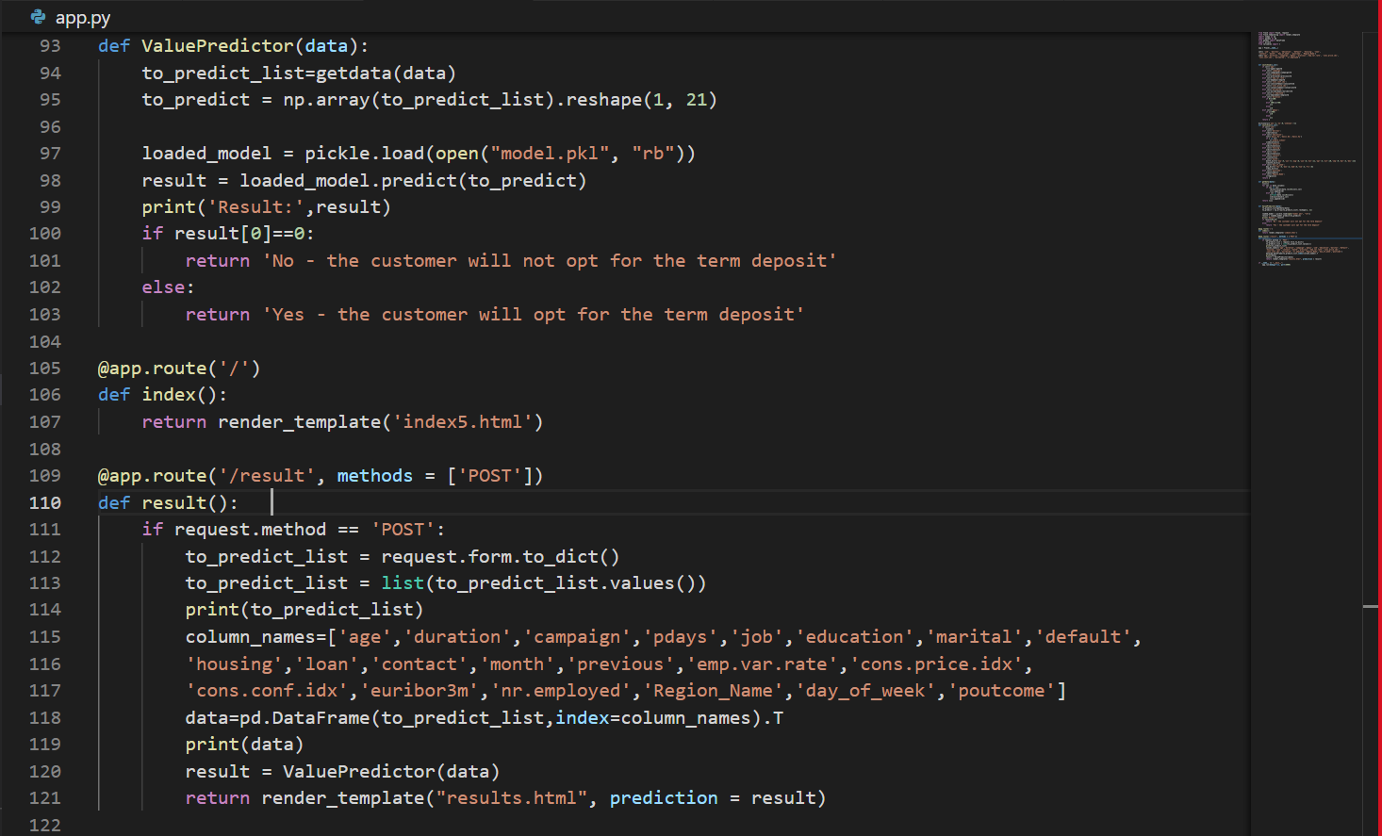
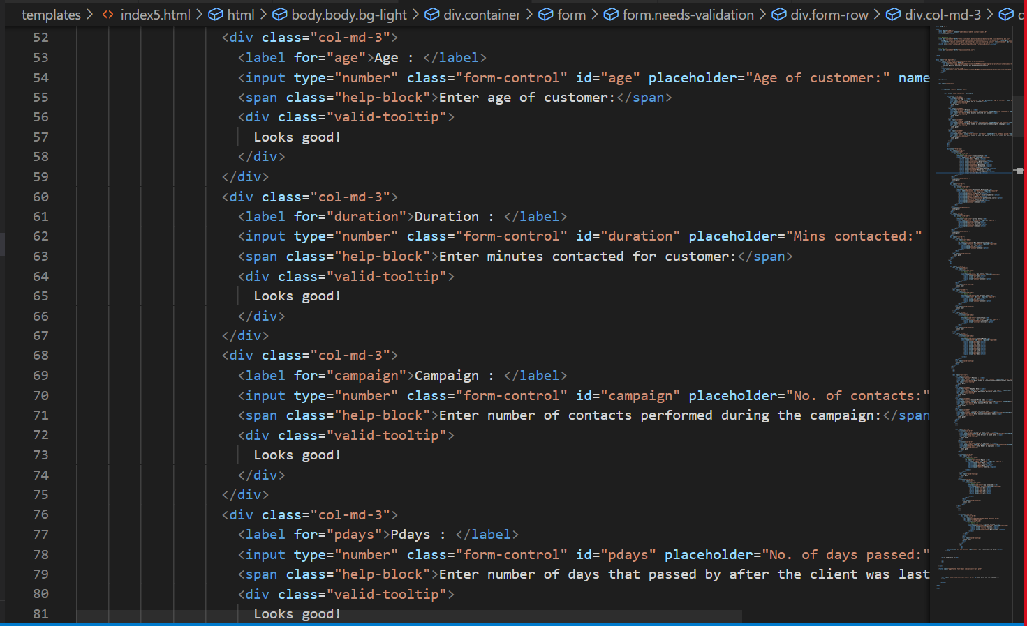
Task 3.3 – Deployment of Models using Flask

Slide 9
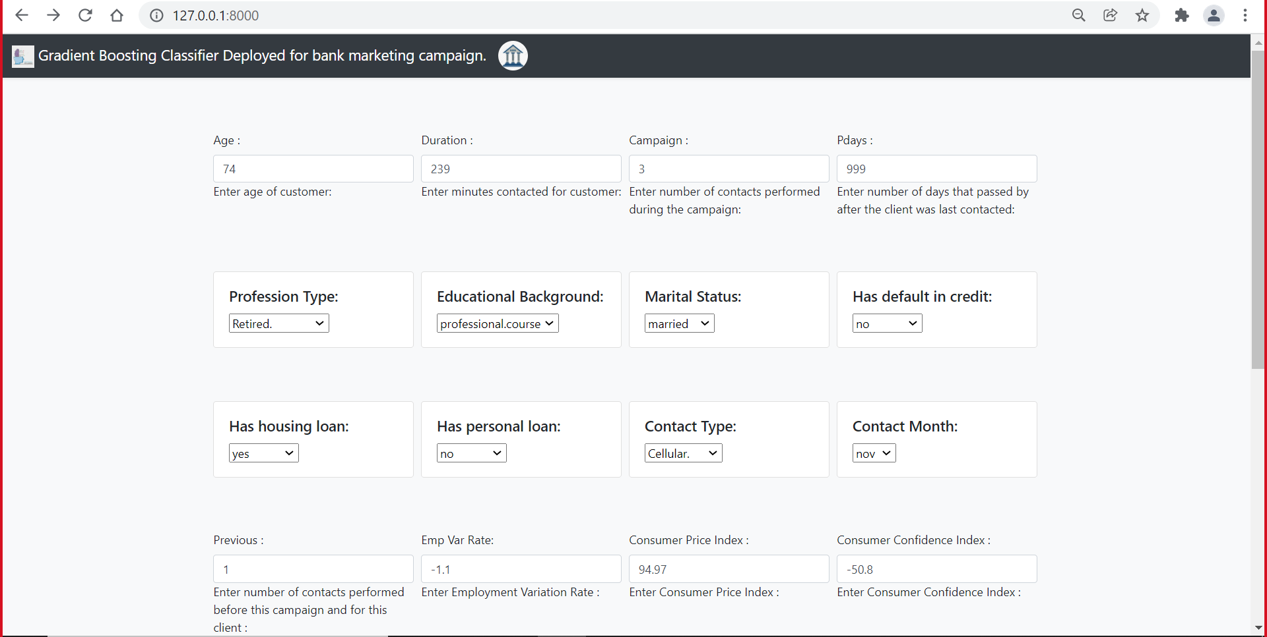
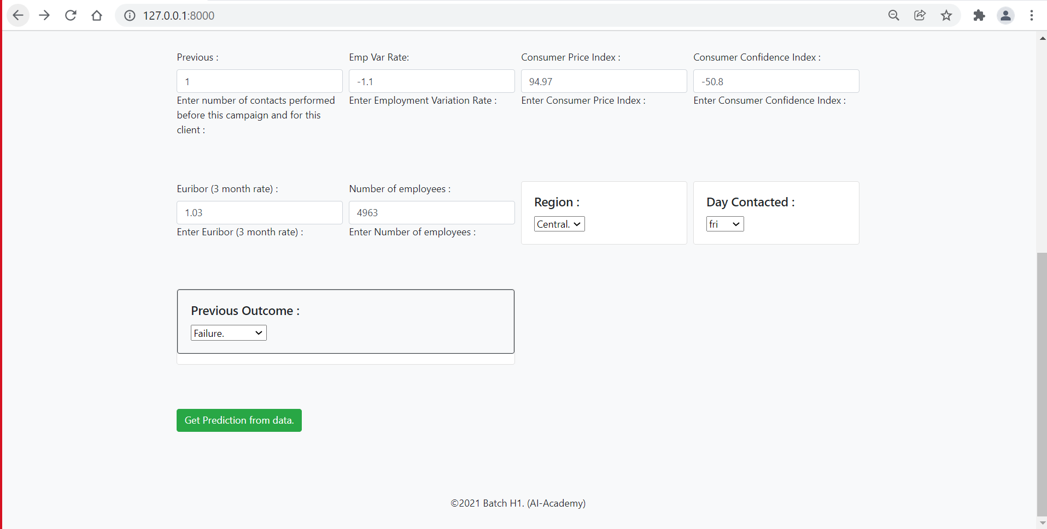
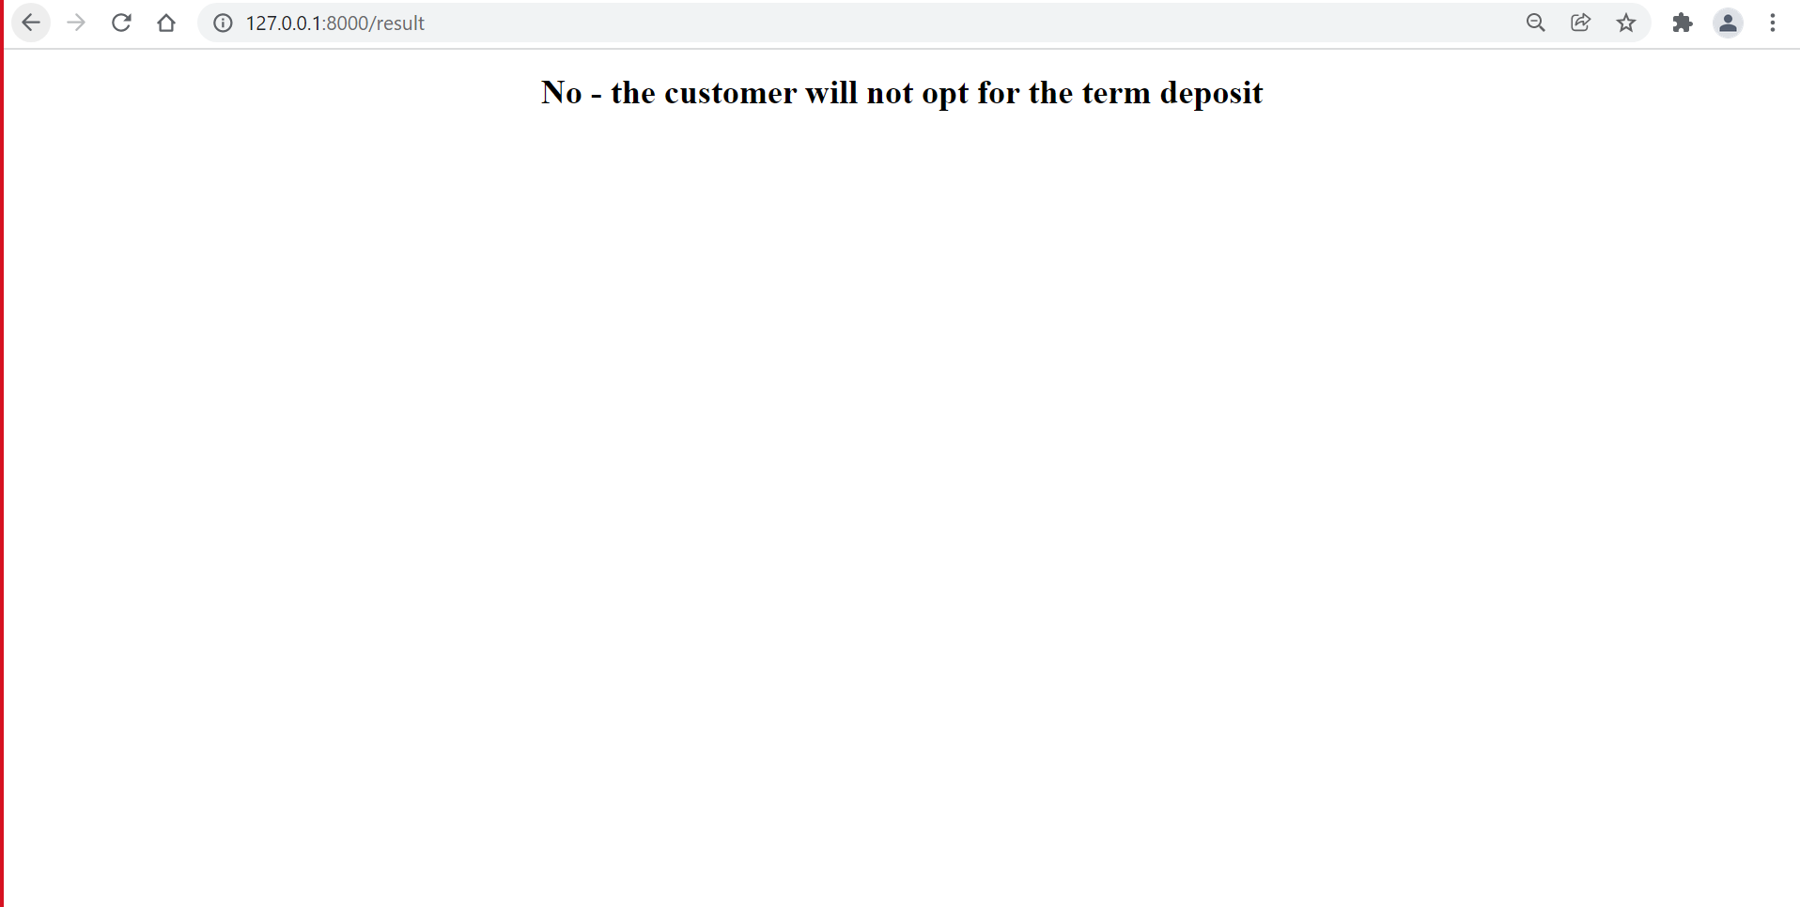

Slide 10
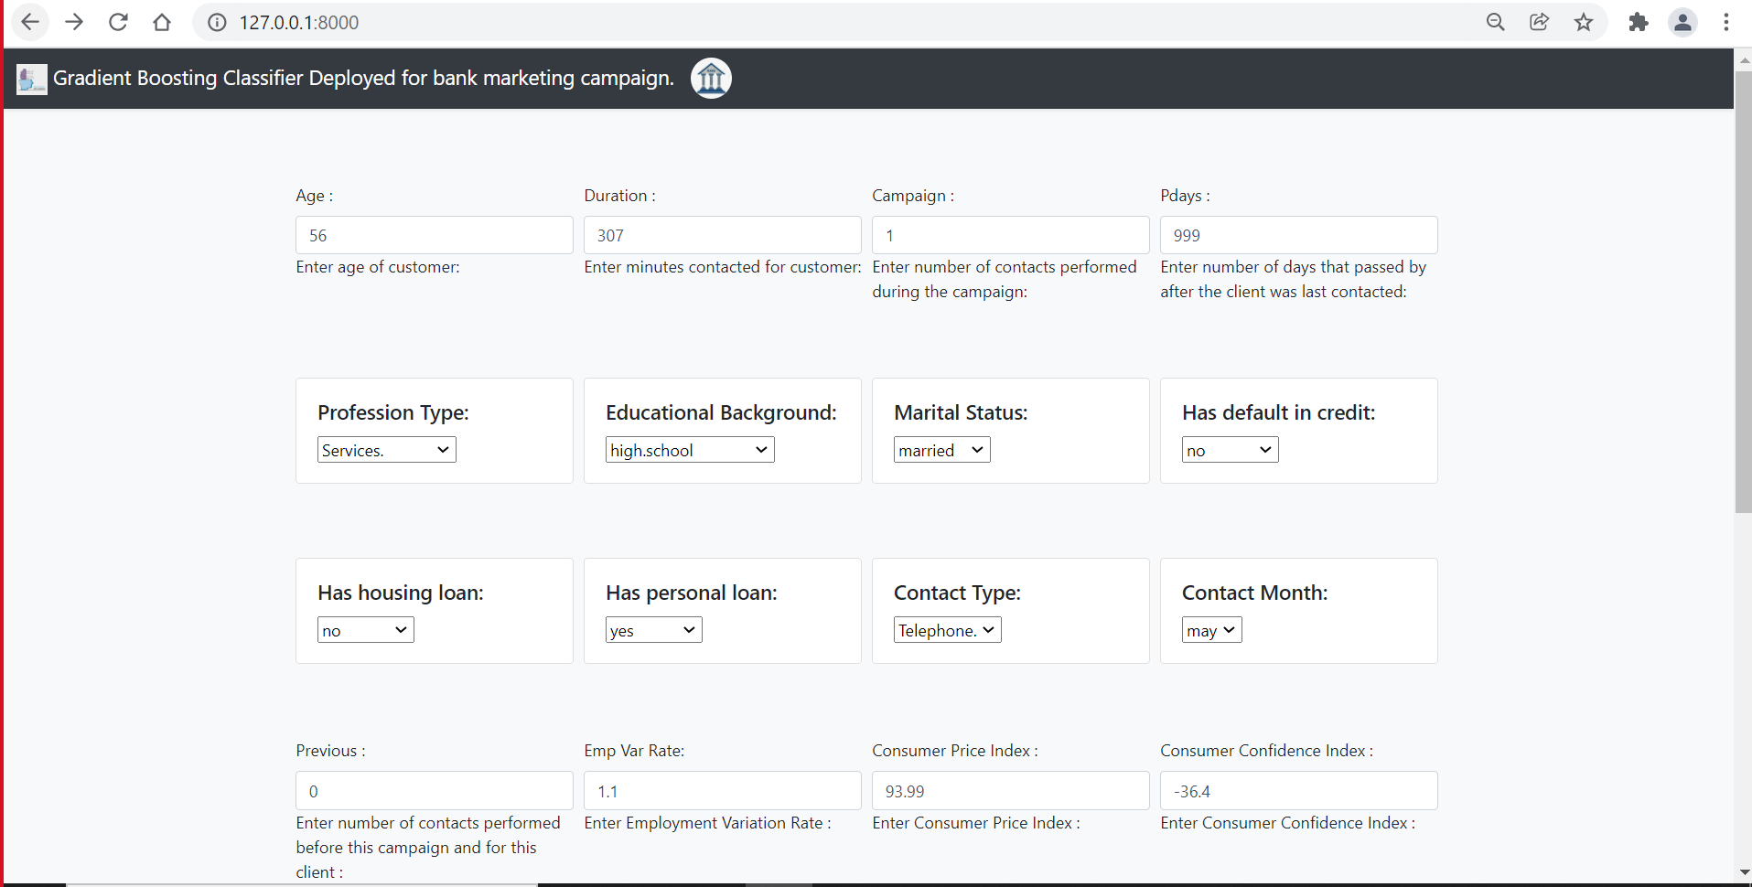
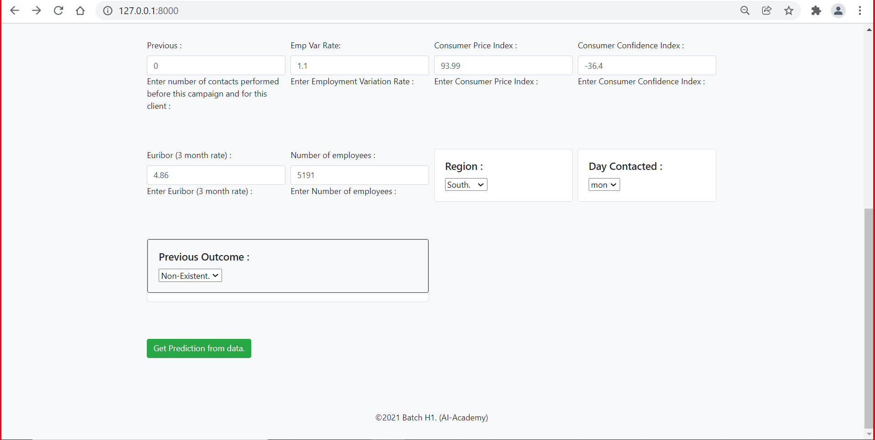
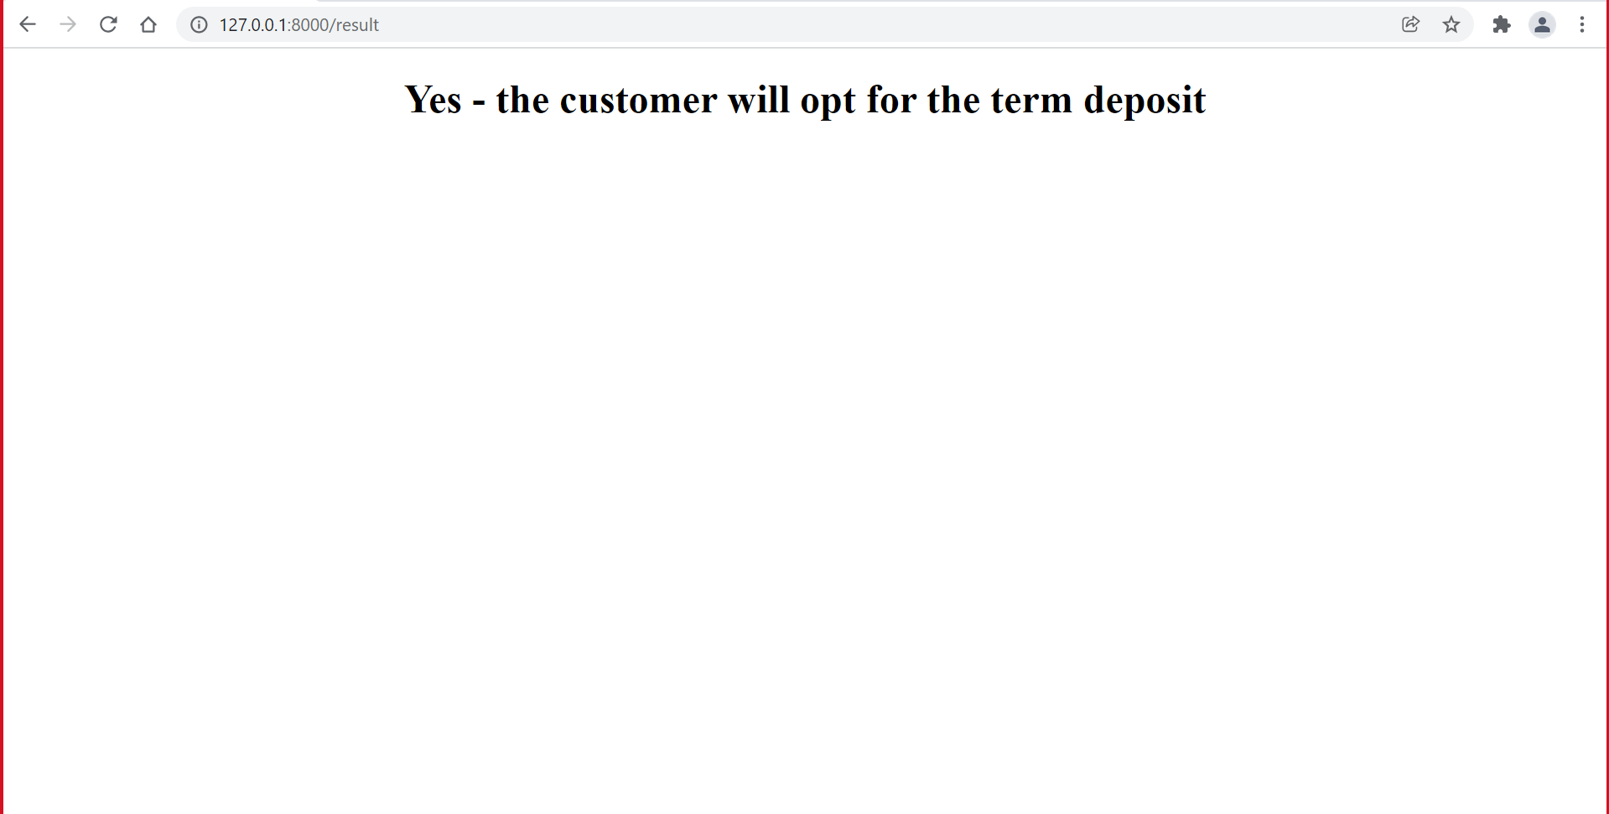

Slide 11
Your best quote that reflects your approach… “It’s one small step for man, one giant leap for mankind.”
- Neil Armstrong

